Slide 1
Fermionic and Bosonic Concentration in a Translationally Invariant Chain
Canonical Typicality and a Different Interpretation to Entropy
Alejandro Ferrero Botero
Universidad de los Andes
May 26 2014

Slide 2
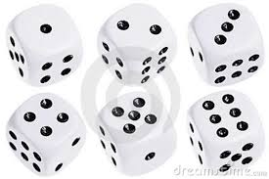
Canonical and Microcanonical Ensembles
Obtained from averaging over a very large amount of possible states; $N\sim {10}^{23}$.
A consequence of the law of large numbers and the central limit theorem
LLL
1, 2, 3, 4, 5, 6. $\overline{x}=3.5$ < x > = ??
Δx -> large
1, 2, 3, 4, 5, 6. $\overline{x}=3.5$ < x > -> 3.5
Δx -> decreases
$\overline{x}=3.5$ < x > = $\frac{1}{\sqrt{N}}$ $N→∞$

Slide 3
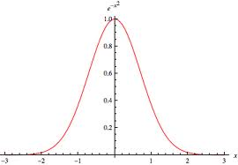
Canonical and Microcanonical Ensembles
CLT

Slide 4
Canonical and Microcanonical Ensembles
For a full system A + B, A -> subsystem B -> thermal bath, the distribution of states in A are gaussian (thermodynamic view).
(Mathematical Reasons)
B
A

Slide 5
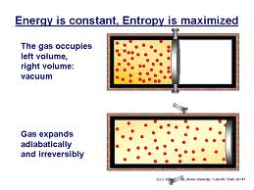
Entropy and Second Law of Thermodynamics
Lack of information over the configuration of a system

Slide 6
Entropy and Second Law of Thermodynamics
Measure of the disorder of a system
Disordered
More likely
Ordered
Less likely

Slide 7
Entropy and Second Law of Thermodynamics
Not quite an extensive property
not macroscopically excited states ground
states.
The state of the entire Universe is completely unknown
$$S\sim A$$
$$S\sim 2πR$$
???

Slide 8
Canonical Typicality
The canonical state distribution of is a generic property of practically all subsystems A of sufficiently enough high dimension
Almost any state that we choose is typical or very close to a gaussian distribution
(Not a mathematical property)
B
A
$$+$$

Slide 9
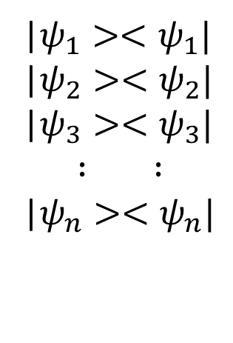
Entropy
Does not come from a lack of information. Entanglement of A with the entire Universe.
The Universe is in a particular unknown pure state -> zero entropy. Can the other pure state configurations contribute to the total entropy?
|$ψ_{1}><ψ_{1}|$
|$ψ_{2}><ψ_{2}|$
|$ψ_{3}><ψ_{3}|$
$$∶ ∶$$
|$ψ_{n}><ψ_{n}|$

Slide 10
Entropy
For macroscopically excited states (the density in the thermodynamic limit is different from zero)
$$S\sim V$$
$$S\sim πR^{2}$$
$$n≠0 N→∞$$

Slide 11
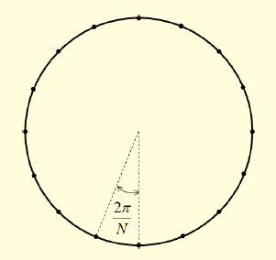
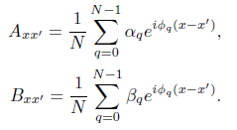
Model (Chain of length N)
Fourier Transform + Bogoliubov transformation

Slide 12
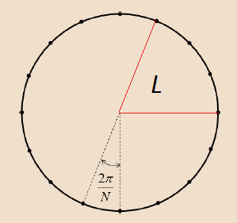
Model (Chain of length L)
Is the Hamiltonian of a
sub-chain of length L the
same than that of length N
restricted to the sub-chain?
Usual definition
Alternative definition

Slide 13
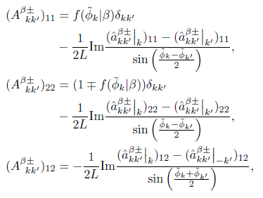
Model (Chain of length L)

Slide 14
Deviations from sample average

Slide 15
Bosonic and Fermionic Concentration
Characteristic function: quasi-probability distribution in phase space
Density Matrix: Describes the thermal state of a particular system
In the sub-chain

Slide 16
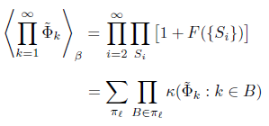
Bosons
Expansion
In Cumulants

Slide 17
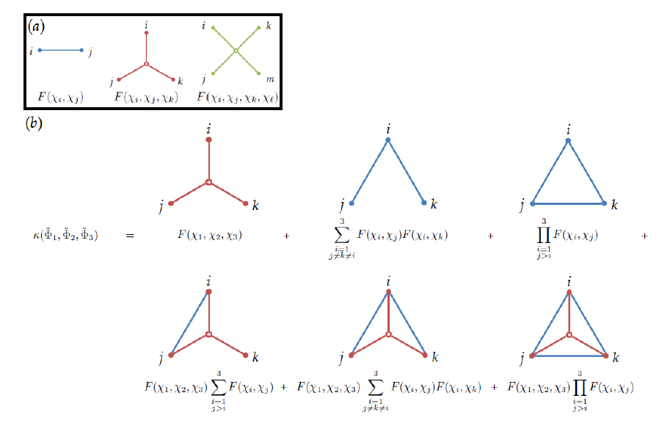
Example

Slide 18
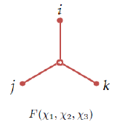
Order of the Cumulants
$$\sim O(1/N)$$

Slide 19
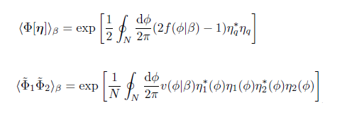
Fermions

Slide 20
Conclusions
Canonical typicality is satisfied in our model
Local states are gaussian by nature, not because of some mathematical properties
The deviation of local states from canonical representation is very small
A different interpretation to the concept of entropy can by applied

