Slide 1


Density Matrix Renormalization Group DMRG
Popayan, 2012
Servio Tulio Pérez M.
Departamento de Física
Facultad de Ciencias Naturales Exactas y de la Educación
Universidad del Cauca

Slide 2
Outline
Objectives
Abstract
Introduction
Theoretical Aspects
The Method
Numerical Importance
Uses
Applications
References

Slide 3
Abstract
The Density Matrix Renormalization Group ($DMRG$) has become a powerful numerical method that can be applied to low-dimensional strongly correlated fermionic and bosonic systems. It allows for a very precise calculation of static, dynamical and thermodynamical properties. Its field of applicability has now extended beyond Condensed Matter, and is successfully used in Statistical Mechanics and High Energy Physics as well. In this work, we briefly review the main aspects of the method. We also comment on some of the most relevant applications so as to give an overview on the scope and possibilities of DMRG and mention the most important extensions of the method such as the calculation of dynamical properties, the application to classical systems, inclusion of temperature, phonons and disorder, field theory, time-dependent properties and the ab initio calculation of electronic states in molecules.

Slide 4
Introduction

Slide 5
Renormalization Group (RG)
Particle Physics
Mathematical apparatus.
Force Laws
QFT
Energy scale (momentum)
Resolution distance scales
that allows systematic investigation of the changes of a physical system as viewed at different distance scales.
Compton
wavelength
Uncertainty
principle

Slide 6
Renormalization Group (RG)
Conformal Invariance
Symmetries
Symmetry of generators
Conformal Transformations
Change in Scale
Scale Transformation.

Slide 7
Renormalizable Theories
self-Similar
copies
Atoms
Elementary particles
Itself Smaller Scale (different parameters)
Atomic
spins

Slide 8
The history Renormalization Group
The idea of scale transformations and scale invariance is old in physics. Scaling arguments were commonplace for the Pythagorean school, Euclid and up to Galileo. They became popular again at the end of the 19th century, perhaps the first example being the idea of enhanced viscosity of Osborne Reynolds, as a way to explain turbulence.

Slide 9
The renormalization group was initially devised in particle physics, but nowadays its applications extend to solid-state physics, fluid mechanics, cosmology and even nanotechnology. An early article [1] by Ernst Stueckelberg and Andre Petermann in 1953 anticipates the idea in quantum field theory. Stueckelberg and Petermann opened the field conceptually. They noted that renormalization exhibits a group of transformations which transfer quantities from the bare terms to the counterterms. They introduced a function h(e) in QED, which is now called the beta function (see below).
1. Stueckelberg, E.C.G. and Petermann, A. (1953). Helv. Phys. Acta, 26, 499.

Slide 10
Murray Gell-Mann and Francis E. Low in 1954 restricted the idea to scale transformations in QED,[2] which are the most physically significant, and focused on asymptotic forms of the photon propagator at high energies. They determined the variation of the electromagnetic coupling in QED, by appreciating the simplicity of the scaling structure of that theory.
The renormalization group prediction (cf Stueckelberg-Petermann and Gell-Mann-Low works) was confirmed 40 years later at the LEP accelerator experiments: the fine structure "constant" of QED was measured to be about 1/127 at energies close to 200 GeV, as opposed to the standard low-energy physics value of 1/137. (Early applications to quantum electrodynamics are discussed in the influential book of Nikolay Bogolyubov and Dmitry Shirkov in 1959.[3])
2. Gell-Mann, M.; Low, F.E. (1954). "Quantum Electrodynamics at Small Distances". Physical Review 95 (5): 1300–1312.
3. N.N. Bogoliubov, D.V. Shirkov (1959): The Theory of Quantized Fields. New York, Interscience.

Slide 11
A deeper understanding of the physical meaning and generalization of the renormalization process, which goes beyond the dilatation group of conventional renormalizable theories, came from condensed matter physics. Leo P. Kadanoff's paper in 1966 proposed the "block-spin" renormalization group.[4] The blocking idea is a way to define the components of the theory at large distances as aggregates of components at shorter distances.
This approach covered the conceptual point and was given full computational substance[5] in the extensive important contributions of Kenneth Wilson. The power of Wilson's ideas was demonstrated by a constructive iterative renormalization solution of a long-standing problem, the Kondo problem, in 1974, as well as the preceding seminal developments of his new method in the theory of second-order phase transitions and critical phenomena in 1971. He was awarded the Nobel prize for these decisive contributions in 1982.
4. L.P. Kadanoff (1966): "Scaling laws for Ising models near ", Physics (Long Island City, N.Y.) 2, 263.
5. K.G. Wilson(1975): The renormalization group: critical phenomena and the Kondo problem, Rev. Mod. Phys. 47, 4, 773.

Slide 12
Theoretical Aspects
of the
renormalization group

Slide 13
Quantum Field Theory

Slide 14
Ultra-violet
divergences
Quantum
fluctuations
Complication & opportunity to find interesting physics
Perturbatibe
QCD
Factorization Theorems for strong interactions
Phenomenological consequences

Slide 15
The structure of a quantum field theory often simplifies when one considers processes involving
large momenta or short distances.
These simplifications are important in improving one's ability to calculate predictions from the theory
One –dimensional Ising model
These manifest themselves in Feynman graphs as divergences
Renormallization is essential
The problem is that there are usually ultra-violet divergences caused by large fluctuations of the field(s) on short distance scales.
The simplification is that the divergences can be cancelled by renormalizations of the parameters of the action
it is necessary to expose the methods to handle high-energy/short distance problems.
Consequently our first task will be to treat the ultra-violet renormalizations.

Slide 16
Strong interaction theory
Make testable predictions
Weakly coupled theory
Rate of convergence
Process involves widely different distance scales.
Factorization of a cross-section.

Slide 17
Ultra-violet divergences
These manifest themselves in Feynman graphs as divergences when loop momenta go to infinity with the external momenta fixed
The simplification is that the divergences can be cancelled by renormalizations of the parameters of the action.
Renormalization is essential, for otherwise most field theories do not exist

Slide 18
Renormalization Theory
Reparametrization
Remove the divergences
Stṻckelberg
Feynman
Quantum electrodynamics
bare parameters (masses, coupling constants)

Slide 19
Lagrange Functions
Physical masses and coupling coefficients
Ultraviolet divergences
Virtual transitions
Connection
Bare and physical quantities
Leaving the renormalized theory finite.

Slide 20
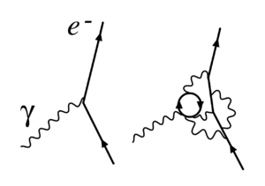
Figure 1. Renormalization in quantum electrodynamics: The simple electron-photon interaction that determines the electron's charge at one renormalization point is revealed to consist of more complicated interactions at another.

Slide 21
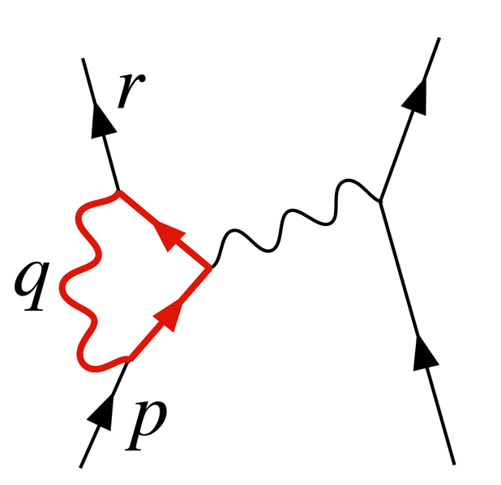
Figure 2. A diagram contributing to electron-electron scattering in QED. The loop has an ultraviolet divergence.

Slide 22
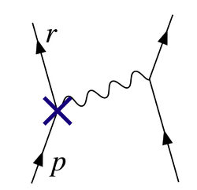
Figure 3. The vertex corresponding to the Z1 counterterm cancels the divergence in Figure 2.

Slide 23
Advantages
The new coupling constants could be smaller.
Free theory without interactions
By repeated applications of the renormalization procedure, one could thus finally obtain
One –dimensional Ising model
The successively interacted coupling coefficients “parameter flow” fixed point
Renormallization Group
Flow in the vicinity of these fixed point can yield information about the universal quantities in the neighborhood of the critical points..
Elimination of degrees of freedom is accompanied by a change of the underlying lattice spacing o length scale , one can anticipate that the fixed points are under certain circumstances related to Critical point.
Two –dimensional Ising model

Slide 24
Finally, the general structure of such transformations will be discussed with the derivation of scaling laws. A brief schematic treatment of continuous field-theoretical formulations will be undertaken following the Ginzburg–Landau theory.

Slide 25
The Method

Slide 26
What is it?
Density matrix renormalization group (DMRG) is a numerical technique for finding accurate approximations of the ground state and the low-energy excited states of strongly interacting quantum systems. Its accuracy is remarkable for one-dimensional systems with very little amount of computational effort. It is however limited by the dimensionality or range of interactions.
The method is kind of “iterative method” and is based on the truncation of the Hilbert space used to represent the Hamiltonian in a controlled way, keeping the most probable eigenstates!
The physical understanding of quantum many-body systems is hindered by the fact that the number of parameters describing the physical states grows exponentially with the number of particles, or size of the system.

Slide 27
More formally in a nutshell: DMRG method
For large systems
Accuracy comparable to exact results
Variational and non-Perturbative
No problems with frustration or fermions
It can calculate:
All ground state properties (energies, correlation functions, gaps, moments)
Finite temperature properties
Classical systems at finite temperature
Dynamical quantities (frequency dependent)
Time evolution
Limitations:
Convergence depends on details of the system (dimensionality, boundary conditions, range of interactions) and efficient programming is very complicated.

Slide 28
Quantum Many-Body Problem
System of N quantum mechanical subsystems
Examples:
Hubbard Model: an effective model for electrons in narrow band (eg, d or f electron metal ions). It is applicable for atoms, clusters, molecules, solids,…..
One-tight binding band, local Coulomb interactions 4^{N} degrees of freedom – states: |0>, , and
Interesting ground state properties: (AFM at half-band filling, n=1), 1D: Luttinger liquid; 2D: d-wave superconductivity (n <1?) Dynamical properties like conductivity and temperature dependence are also quite interesting.

Slide 29
Heisenberg model:
Strong coupling limit of the Hubbard model at n=1 Antiferromagnetic exchange J=4t²/U
Localized QM spin degrees of freedom: (2S+1)^{N} for N spin-S objects.
A model to describe quantum magnetism in most of the oxide materials or any system with localized spin orbitals.
Bethe-ansatz (closed form exact) solution exist only in 1D.
A good model for describing the parent phase of high-T_{c} cuprates
Ground state, dynamics and low-temperature properties quite interesting.

Slide 30
How does one study many-body interactions?
Analytic:
Mean-field theories
Strong and weak coupling expansions (perturbative methods)
Field theoretical methods
Mostly uncontrolled
Numerical:
Exact diagonalization
Configuration Interactions and Coupled Cluster
Quantum Monte Carlo
Dynamical mean-field theory (DMFT)
DMRG
Extremely involved, each method has its own difficulties
Microscopic understanding of systems for applications in magnetic, optical,
electrical, mechanical, transport…..phenomena

Slide 31
What is RG Method?

Slide 32
What is RG Method?
The basic idea behind a renormalization group method is to apply a transformation to the Hamiltonian which eliminates unimportant degrees of freedom for the description of the system within a given energy range.
dE is a small energy interval
For example, if we are interested in the low-energy states of a system with a energy cut-off E, one integrates out energy modes with energy
Then we rescale the parameters of the new system so that it reproduces the previous one.
Given a H of a system with N variables, a RG transformation R_{a} is a mapping in the Hamiltonian space which maps H to H’ : H’=Ra(H). H’ now has N’ variables where N’=N/a which is less than N.
RG transformation must be unitary; i.e., it has to preserve Z=Tr exp(-H/kT) so that Z_{N’}[H’] = Z_{N} [H].

Slide 33
However, an exact transformation is not possible.
Wilson and others:
Work in Fourier space and use a perturbative scheme in order
to analytically solve this problem.
Extremely successful method for solving
Kondo problem and Anderson Impurity problem
K. G. Wilson and F. Kogut, J. Phys. Rep C 12, 75 (1974).
K. G. Wilson, Rev. Mod. Phys. 43, 773 (1975).
H. R. Krishnamurthy, J. W. Wilkins and K. G. Wilson, Phys. Rev. B
21, 1044 (1980).

Slide 34
Numerical Importance

Slide 35
Numerical Renormalization Group (K. G. Wilson, 1974).
Can it be applied for Correlated Lattice problem?
Idea behind all lattice renormalization group methods is to enlarge the system iteratively but keeping only a constant number of basis states.
Integrate out the degrees of freedom numerically for obtaining low-energy properties.
Let H be a Hamiltonian describing an interacting electronic systems on a lattice with L sites. Each site has four states: |0>, |down>, |up> & |2>.
The dimension of the Hilbert space for L=100 with N_{up}=N_{down}=50 is 10⁵⁸, which is not intractable numerically. The idea is to obtain the Low-energy eigen-states of this system keeping only a small number ofstates, say 100.

Slide 36
REAL Space algorithm
Let B_{l} be a block describing the first l sites for which we only keep m states to describe the H.
The same goes for B_{l’} block also with m’ states.
When we put these two blocks together, the H of the new block B_{l+l’} has dimensions mm’.
Solve H _{l+l’} and keep only lowest m energy eigenstates
  Isolate a finite system (N)
  Diagonalize numerically
  Keep m lowest energy eigenstates
  Add another finite system (N)
  Solve (2N) system and iterate the process.

Slide 37
By iterating this procedure, one obtains recursion relations on the set of coupling constants which define the Hamiltonian and the properties in the thermodynamic limit.
The message:
Low-energy states are most important for low-energy behavior of larger system
However, only for Kondo lattice or Anderson impurity models

Slide 38
Very bad for other quantum lattice models:
Hubbard (Bray, Chui, 1979)
Heisenberg (White, 1992, Xiang and Gehring, 1992)
Anderson localization (Lee, 1979)
Kondo impurity problem: Hierarchy in the matrix elements; Boundary conditions seem not important.
Just have a look for a tight-binding model: 2t_{ii} – t_{i, i+1} – t _{i, i-1}
If one puts two blocks together: does not represent the full system
Another way….

Slide 39
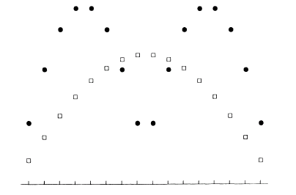
Two same size boxes (of length L, 1D, 1-electron problem)
Will putting together the ground states of L-length box give rise to the ground state of box of size 2L? NO
Treatment of boundary
becomes critical:
Gr states of a chain of 16 atoms (open) and two 8 atoms chains (filled)

Slide 40
When boundary becomes critical: (White and Noack, 1992)
Use combinations of boundary conditions (BCs):
Diagonalize a block, H_{L} with different combinations of BCs.
Use orthogonalized set of states as new basis.
Fluctuations in additional blocks allow general behavior at boundaries.
H_{L}
Fixed-Fixed Fixed-Free Free-Free Free-Fixed
H_{L}
H_{L}
H_{L}
H_{L}
2L
Diagonalize superblock composed of n blocks (each block size L).
Project wavefunctions onto size 2L block, orthogonalize.
Exact results as n becomes large

Slide 41
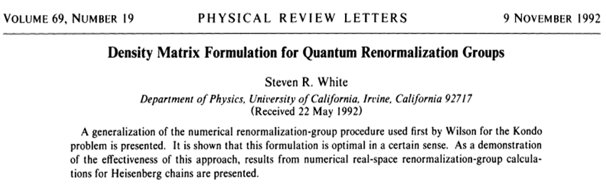
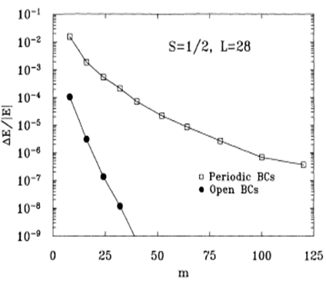
The total number of states is 2²⁸
This amazing accuracy is achieved by just keeping only ~100 states!
Relative error vs no of states kept

Slide 42
[1] S. White, Phys. Rev. Lett. 69, 2863 (1992)
[2] Density Matrix Renormalization, edited by I. Peschel, X. Wang, M. Kaulke and K. Hallberg
(Series: Lecture Notes in Physics, Springer, Berlin, 1999)
[3] S. White, Phys. Rev. B 48, 10345 (1993)
[4] J. Bray and S. Chui, Phys. Rev. B 19, 4876 (1979)
[5] C. Pan and X. Chen, Phys. Rev. B 36, 8600 (1987); M. Kovarik, Phys. Rev. B 41, 6889 (1990)
[6] T. Xiang and G. Gehring, Phys. Rev. B 48, 303 (1993)
[7] K. Wilson, Rev. Mod. Phys. 47, 773 (1975)
[8] S. White and R. Noack, Phys. Rev. Lett. 68, 3487, (1992); R. Noack and S. White, Phys. Rev.
B 47, 9243 (1993)
[9] J. Gaite, Mod. Phys. Lett. A16, 1109 (2001)
[10] R. Noack and S. White in Ref. [2], Chap. 2(I)
[11] M. Mart´ın-Delgado, G. Sierra and R. Noack, J. Phys. A: Math. Gen. 32, 6079 (1999)

Slide 43
Use of density matrix

Slide 44

Use of density matrix
Steven White, 1992
Divide the many-body system: how?
Density matrix projection
Divide the whole system into a subsystem and an environment
We know the eigenfunction for the whole system: how to describe the subsystem block best?
Reduced density matrix for the subsystem block:
Trace over states of the environment block, all many-body states.

Slide 45
Applications

Slide 46
Applications:
Strongly correlated electronic systems
Nuclear Physics
Quantum information theory
Quantum Chemistry
Classical Statistical Physics
Soft condensed matter Physics
Total number of papers published with the string “density matrix renormalization” in their title or abstract from 1993 to 2005 is more than 5,000 (obtained from ISI database) and 2006-2012 aprox. 3000 more.
Distributed Multimedia Research Group
Design Methodology Research Group
Direct Marketing Resource Group
Data Management Resource Group
Groupe de Renormalisation de la Matrice Densite (GRMD) !!!
All are DMRG indeed !

Slide 47
Solid State Physics

Slide 48
Onset dynamical systems
The convergence Fourier Series
Theory
Fermi surfaces
Fermi Liquids
KAM Theory
Theory Euclidean
fields
C.P
Theory
Renormalization
Group
Renormalization
Group

Slide 49
The renormalization is also a standard tool in the field of condensed matter physics, where it is used to describe the collective excitations of many-particle systems, and explain phenomena such as superconductivity, superfluity and the quantum Hall effect

Slide 50
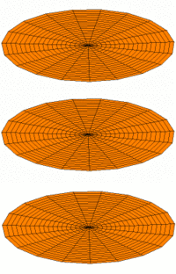
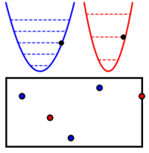
Modos normales. Los modos normales de un sistema físico son sus vibraciones colectivas más simples, como las de esta membrana elástica.
Segunda cuantización. Un sistema de dos osciladores cuánticos es equivalente a un sistema con un número variable de partículas de «dos clases».

Slide 51
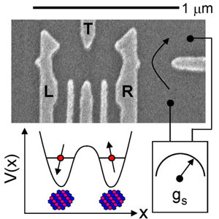
Gate defined double quantum dot fabricated from a GaAs/AlGaAs 2-dimensional electron gas wafer. The number of electrons in the double quantum dot is determined by measuring the quantum point contact charge sensor conductance, gS. Trapped electrons are coupled to ~106 lattice nuclei through the contact hyperfine interation.

Slide 52
Spin Wave Theory
Heisenberg Chain
S=1
Spin Gap
Correlation
Functions
Anisotropic Chain
S=1
Systems
S = 1/2
1D Hubbard
and
T-J models

Slide 53
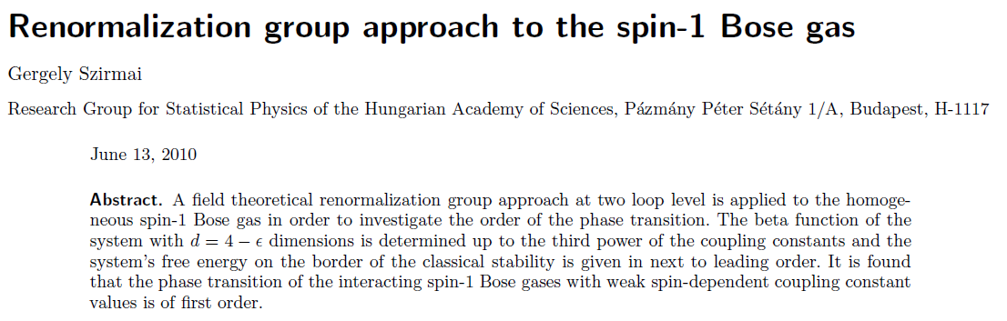

Slide 54
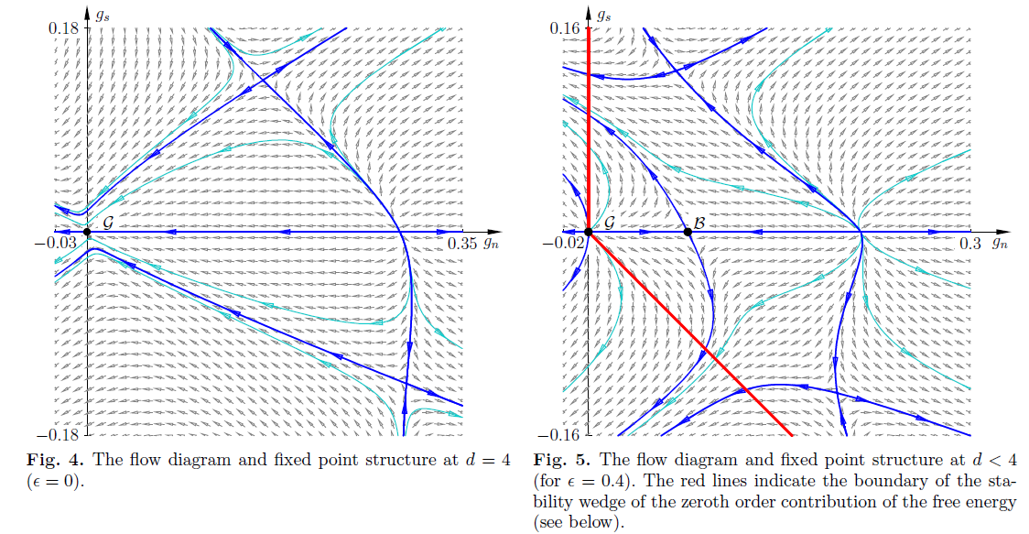

Slide 55
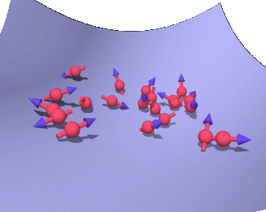

Slide 56
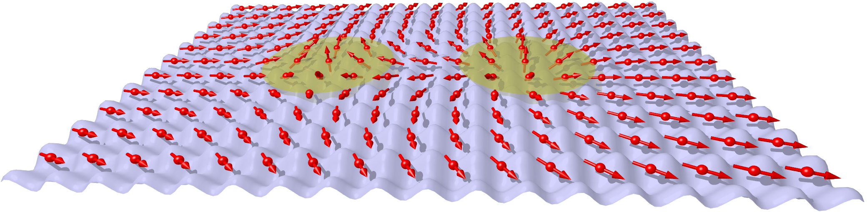

Slide 57
[12] S. R. White and D. Huse, Phys. Rev. B 48, 3844 (1993)
[13] E. S. Sørensen and I. Affleck, Phys. Rev. B 49, 13235 (1994)
[14] E. S. Sørensen and I. Affleck, Phys. Rev. B 49, 15771 (1994); E. Polizzi, F. Mila and E.
[15] E. Ercolessi, G. Morandi, P. Pieri and M. Roncaglia, Europhys. Lett. 49, 434 (2000)
[16] S. Qin, X. Wang and Lu Yu, Phys. Rev. B 56, R14251 (1997)
[17] Y. Yamashita, N. Shibata and K. Ueda, Phys. Rev. B 58, 9114 (1998); J. Phys. Soc. Jpn.
Vol.69, 242-247 (2000); Phys. Rev. B 61, 4012 (2000)
[18] A. Laeuchli, G. Schmida and M. Troyer, cond-mat/0206153
[19] T. Hikihara, T. Momoi and X. Hu, cond-mat/0206102
[20] T. Nunner, P. Brune, T. Kopp, M. Windt and M. Gr¨uninger, cond-mat/0203472
[21] Y. Honda and T. Horiguchi, cond-mat/0106426

Slide 58
Phonons, bosons and disorder
Phonon
Pseudo-site system
Holstein model
for several
hundred sites
Ground state energy of the polaron problem
Electronic and phononic degrees of freedom
Interactions induced by quantum fluctuations in quantum strings
1D rRndom
and
disordered ystems

Slide 59
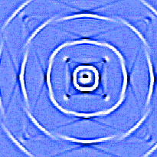

Slide 60
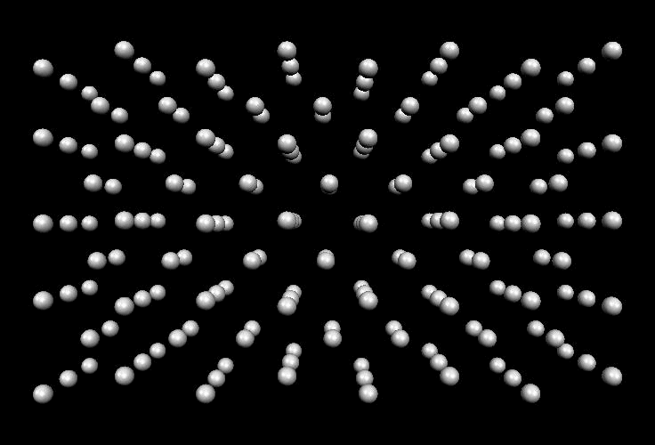

Slide 61
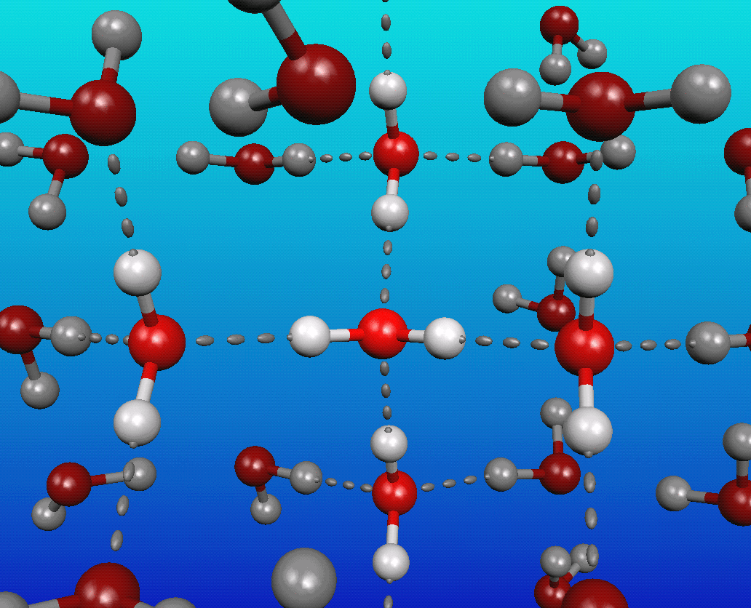

Slide 62
[22] L. Caron and S. Moukouri, Phys. Rev. Lett. 76, 4050 (1996); Phys. Rev. B 56, R8471 (1997)
[23] E. Jeckelmann and S. White, Phys. Rev. B 57, 6376 (1998)
[24] R. Noack, S. White and D. Scalapino in Computer Simulations in Condensed Matter Physics
VII, edited by D. Landau, K.-K. Mon and H.-B. Sch¨uttler (Springer Verlag, Heidelberg and
Berlin, 1994)
[25] E. Jeckelmann, C. Zhang and S. White in Ref. [2], Chap. 5.1 (II)
[26] C. Zhang, E. Jeckelmann and S. White, Phys. Rev. Lett. 80, 2661 (1998); E. Jeckelmann, C.
Zhang and S. R. White, Physical Review B 60, 7950 (1999)
[27] Y. Nishiyama, cond-mat/0102123
[28] Eur. Phys. J. B 12, 547 (1999)
[29] R. Bursill, Y. McKenzie and C. Hammer, Phys. Rev. Lett. 80, 5607 (1998); 83, 408 (1999);
R. Bursill, Phys. Rev. B 60, 1643 (1999)

Slide 63
Molecules and Quantum Chemistry
Molecules
And
polymers
conjugated organic systems (polymers)
conjugated one-dimensional semiconductors
ab initio calculation of electronic states in molecules
Standard Hartree-Fock (HF) Bases
Interactions
are long-ranged

Slide 64
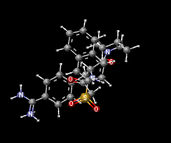

Slide 65
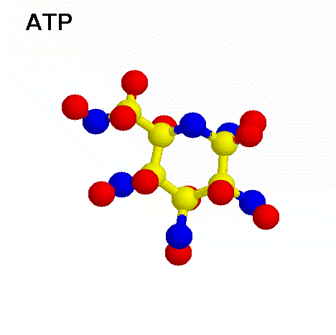

Slide 66
[30] G. Fano, F. Ortolani and L. Ziosi, J. Chem. Phys. 108, 9246 (1998),(cond-mat/9803071); R.
Bursill and W. Barford, Phys. Rev. Lett. 82, 1514 (1999)
[31] M. Exler and J. Schnack, cond-mat/0205068
[32] B. Normand, X. Wang, X. Zotos and Daniel Loss, Phys. Rev. B 63, 184409 (2001)
[33] C. Raghu, Y. Anusooya Pati and S. Ramasesha, Journal-ref: J. Phys. A 34, 11215 (2001)
[34] W. Barford and R. Bursill, Chem. Phys. Lett. 268, 535(1997); W. Barford, R. Bursill and M.
Lavrentiev, J. Phys: Cond. Matt, 10, 6429 (1998); W. Barford in Ref.[2], Chap.2.3 (Part II)
and references therein; M. Lavrentiev, W. Barford, S. Martin, H. Daly, R. Bursill, Physical
Review B 59, 9987 (1999)

Slide 67
Dynamical correlation functions
Calculate dynamical response functions
Nuclear magnetic resonance
(NMR)
Neutron Scattering
Optical
Absorption
Photoemission
Response functions in single impurity systems

Slide 68
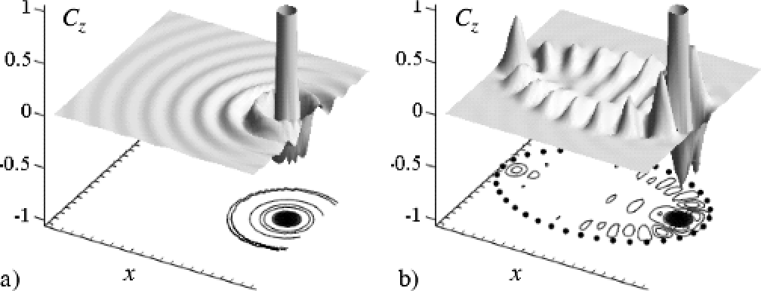
Spin correlation functions Cz between the impurity and conduction band

Slide 69
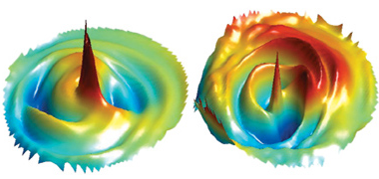
Spin correlation functions Cz between the impurity and conduction band

Slide 70
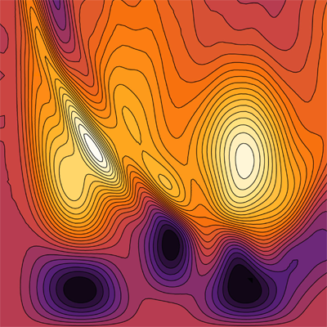
Image from "Passing quantum correlations to qubits using any two-mode state" [Mauro Paternostro, Gerardo Adesso, and Steve Campbell, Phys. Rev. A 80, 062318 (2009)]

Slide 71
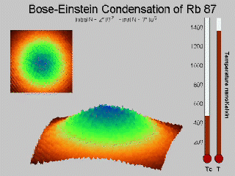
Image from "Passing quantum correlations to qubits using any two-mode state" [Mauro Paternostro, Gerardo Adesso, and Steve Campbell, Phys. Rev. A 80, 062318 (2009)]

Slide 72
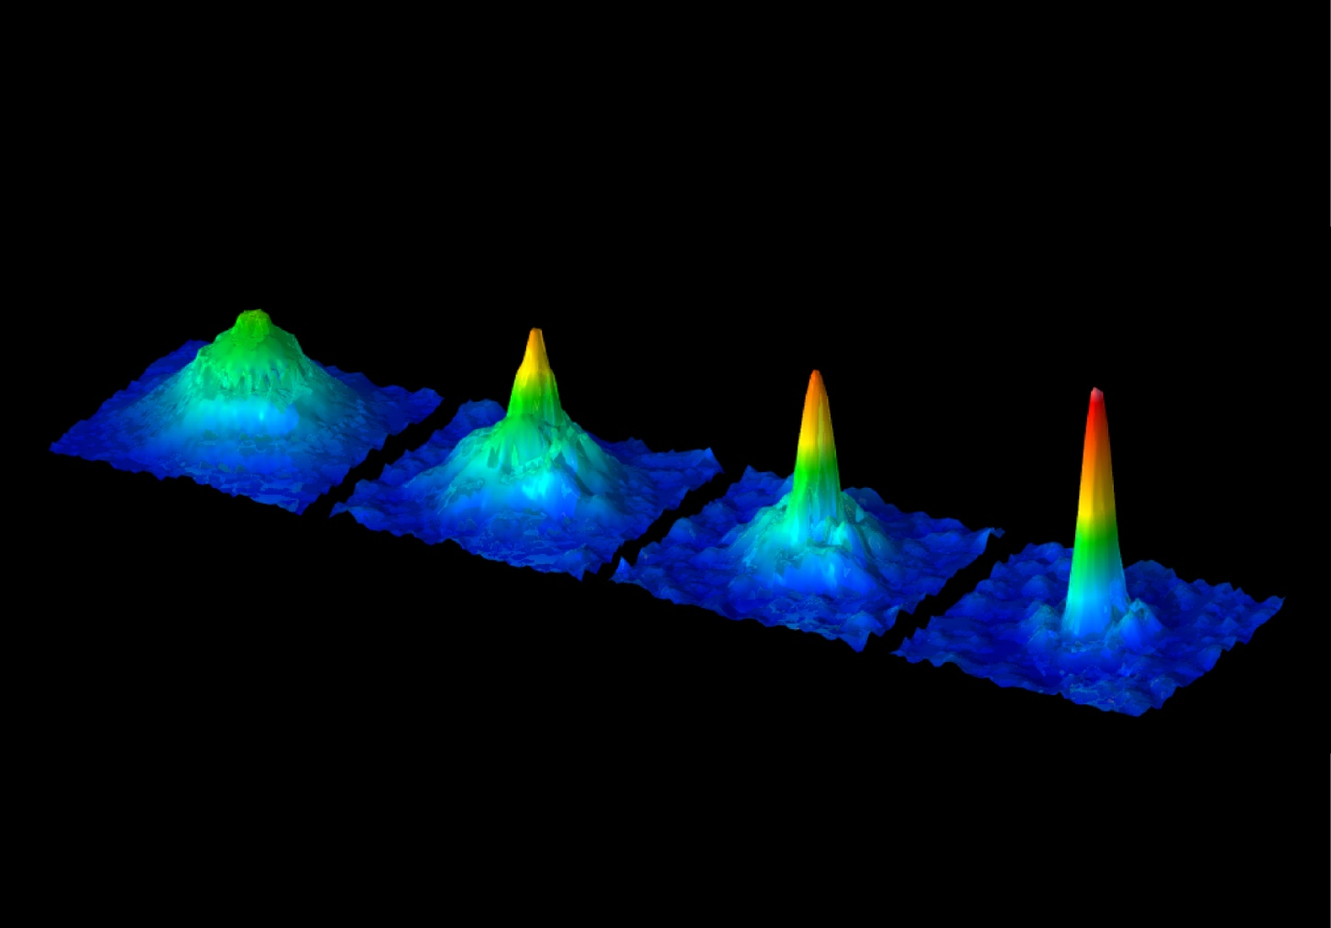
BEC in a dilute atomic gas, extremely low temperatures are required. Our experimental setup employs a combination of laser cooling and evaporative cooling to produce cold and dense atomic clouds in a vacuum system. A double magneto-optical trap system captures and cools up to 6x 109 87Rb atoms using laser light.

Slide 73
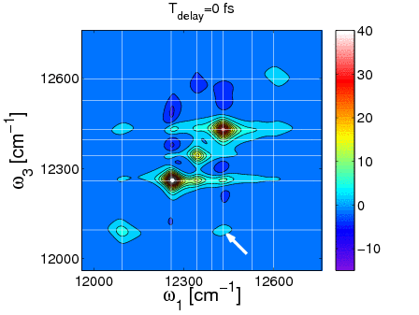
he animation shows how peaks in the 2d echo-spectra are oscillation and changing for various delay times. For a full explanation, see Modelling of Oscillations in Two-Dimensional Echo-Spectra of the Fenna-Matthews-Olson Complex by B.Hein, C. Kreisbeck, T. Kramer, M. Rodríguez, New J. of Phys., 14, 023018 (2012), open access.

Slide 74
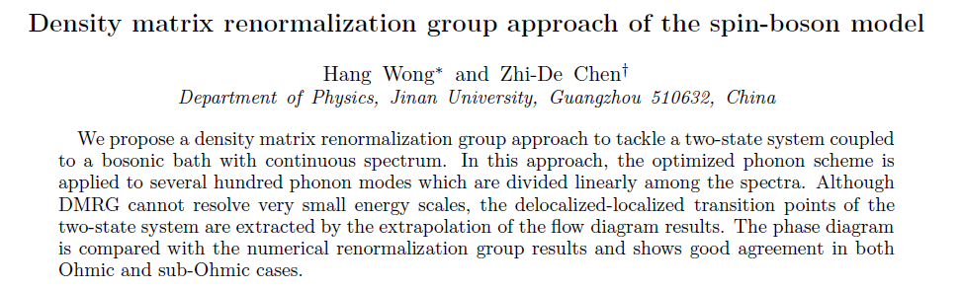
arXiv:0801.3937v2 [cond-mat.str-el], 2008. http://xxx.lanl.gov/abs/0801.3937

Slide 75
[35] ¨O. Legeza, J. Roder and B. A. Hess, cond-mat/0204602
[36] W. Hofstetter, Phys. Rev. Lett. 85, 1508 (2000)
[37] M. A. Cazalilla and J. B. Marston, Phys. Rev. Lett. 88, 256403 (2002)
[38] K. Hallberg, Phys. Rev. B 52, 9827 (1995).
[39] E. R. Gagliano and C. A. Balseiro, Phys. Rev. Lett. 59, 2999 (1987).
[40] G. Grosso and G. Partori Parravicini, in Memory Function Approaches to Stochastic Problems
in Condensed Matter, Adv. in Chemical Physics, 62, 133 (Wiley, N. Y., 1985)
[41] P. Horsch and W. von der Linden, Z. Phys. B 72 181 (1981)
[42] J. des Cloiseaux and J. J. Pearson, Phys. Rev. 128, 2131 (1962)
[43] T. Yamada, Prog. Theor. Phys. Jpn. 41, 880 (1969); L. D. Fadeev and L. A. Takhtajan, Phys.
Lett. 85 A, 375 (1981)
[44] G. M¨uller, H. Thomas, H. Beck and J. Bonner, Phys. Rev. B 24, 1429 (1981) and references
therein.

Slide 76
References

Slide 77
[45] McComb W.D. Renormalization methods. A guide for beginners. Oxford, printing edition, 2004.
[46] Salmhofer M. Renormalization.. an introduction. Springer, 1 printing edition,1999.
[47] Hoser A. Renormalization Group Theory.. Impact on Experimental Magnetism (Springer, 2009).
[48] Zeidler E. Quantum field theory Vol 1, 2, 3.. Basics in mathematics and physics.. a bridge between mathematicians and physicists (Springer, 2006).
[49] Kleinert H. Gauge fields in condensed matter. Vol 1, 2 (WS, 1990). Schwabl F. Statistical Mechanics (2nd ed., Springer, 2006)

Slide 78
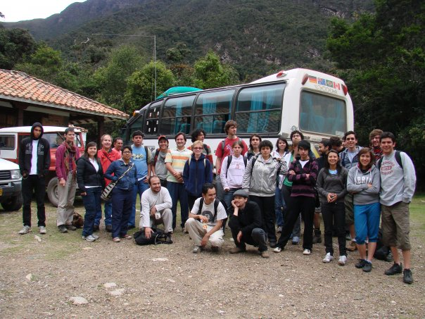

Slide 79
Conclusions

Slide 80
I have presented here a very brief description of the Density Matrix Renormalization Group technique, its applications and extensions. The aim of this work is to give the unexperienced reader an idea of the possibilities and scope of this powerful, though relatively simple method. The experienced reader can find here an extensive (however incomplete) list of references covering most applications to date using DMRG in a great variety of fields such as Condensed Matter, Statistical Mechanics and High .Energy Physics.

Slide 81
Thank you

Slide 82
Appendix The Method

Slide 83
Density Matrix
“When we solve a quantum-mechanical problem, what we really do is
divide the universe into two parts – the system in which we are
interested and the rest of the universe.”
- Richard P. Feynman
(Statistical Mechanics : A set of lectures; Westview press, 1972)
When we include the part of the universe outside the system, the
motivation of using the density matrices become clear.
So what does this mean ?

Slide 84
Let be a complete set of vectors in the vector space describing the
system, and let be a complete set for the rest of the universe.
The most general way to write the wave function for the total system is
Now let A be an operator that acts only on the system, ie A does not act
on
Now we have,
Density Matrix

Slide 85
We define the operator ρ to be such that,
Note that ρ is Hermitian.
Again,
= Tr Aρ
Due to the Hermitian nature of ρ it can be diagonalized with a complete
orthonormal set of eigenvectors with real eigenvalues

Slide 86
So, we have <y|A|y> = Tr Ar and
If we let A be 1, we obtain
If we let A be we have
Therefore, we have
and
Orthonormal set of eigenvectors and real eigenvalues.

Slide 87
Any system is described by a density matrix ρ, where ρ is of the form
and
The set is a complete orthonormal set of vectors.
Given an operator A, the expectation of A is given by
Notice that,
Thus, is the probability that the system is in state . If all but one
are zero, we say that the system is in a pure state; otherwise it is
in a mixed state .

Slide 88
1
Consider a pure state:
Notice that ρ² = ρ
and
Tr ρ = 1
2
Consider a mixed state: 50% and 50%
Notice that ρ² ≠ ρ
and
Tr ρ = 1

Slide 89
3
50% and 50% mixture of
&
Notice that ρ² ≠ ρ
and
Tr ρ = 1
Diagonal elements = Populations
Off-diagonal elements = Coherence
It is important to note that in 2 and 3, both cases we describe
a system about which we know nothing, ie, A state of total ignorance.

Slide 90
Density matrix:
Eigenstates of density matrix form complete basis for subsystem block
Eigenvalues give the weight of a state
Keep the m eigenstates corresponding to m highest eigenvalues
Eigenstate of the whole system thus given by:
Schmidt decomposition
The optimal approximation
Entanglement states (mutual quantum information):
DM can be defined for pure, coherent superposition or statistical averaged states

Slide 91
Density matrix renormalization group: Formulation
Diagonalization of a small finite lattice
Division of system
Reduction of the subsystem block via density matrix
Renormalize the matrix formulation of all the operators
Add one or two sites (few possible degrees of freedom)
Construct the bigger lattice
Repeat all the steps
Environment block:
a) Exact sites only
b) Reflection of subsystem block
c) Stored block from a previous step

Slide 92
[50] R. Feynman, Statistical Mechanics: A Set of Lectures, (Benjamin, Reading, MA, 1972)
[ [51] E. R. Davidson, J. Comput. Phys. 17, 87 (1975); E.R. Davidson, Computers in Physics 7, No.
5, 519 (1993).
[52] S. ¨Ostlund and S. Rommer, Phys. Rev. Lett. 75, 3537 (1995); Phys. Rev. B 55, 2164 (1997);
M. Andersson, M. Boman and S. ¨Ostlund, Phys. Rev. B 59, 10493 (1999); H. Takasaki, T.
Hikihara and T. Nishino, J. Phys. Soc. Jpn. 68, 1537 (1999); K. Okunishi, Y. Hieida and
Y.Akutsu, Phys. Rev. E 59, R6227 (1999)
[53] M. A. Mart´ın-Delgado and G. Sierra, Int. J. Mod. Phys. A, 11, 3145 (1996)
[54] G. Sierra and M. A. Mart´ın-Delgado, in ”The Exact Renormalization Group ” by a Krasnitz,
R Potting, Y A Kubyshin and P. S. de Sa (Eds.) World Scientific Pub Co; ISBN: 9810239394,
(1999), (cond-mat/9811170)

Slide 93
Thank you

